Slide 1
Educational
.
What is one question you would like to ask a magician? Why?
Idioms
Keep an eye on
Take into consideration
Pick up on
Keep tabs on
Put your mind to
Hammer away at
Give it a shot
Pull out all stops
Arrive at a decision
Snap decision
I smell a rat
Touch and go
It goes without saying
Crystal clear
What is the bottom right-hand icon on your cell phone
What can you observe around you? What can you remember?
Brain Magic
If you had a magic pen, what could it do? https://youtu.be/7EP1dnaI2X8
.
…
Christopher Bauman – www.chrisbauman.com.au

Slide 2
1. Discuss how the magician did the mind trick ____________________________________________________________________________________________?
Advanced Question Words
2. How would you react if you were I that car ___________________________________________________________________________________________ ?
Illusion
Skeptical
3. How was the magician driving the can without his sight ___________________________________________________________________________________________ ?
Volunteer
Have the last laugh
4 Describe the most scary thing you have ever done ___________________________________________________________________________________________ ?
Round of applause
5. When have you felt skeptical? ___________________________________________________________________________________________ ?
perceptive
6. When have you made a good decision ___________________________________________________________________________________________ ?
7. Would you rather be in the audience or on stage? Why? ___________________________________________________________________________________________ ?
observation
Slide of hand
8. What is something that you look at every day that you are blinded to? Ex a chiming clock ____________________________________________________________________________________________ ?
Observation and action
How good are your observational skills?.... Test it out
.
Christopher Bauman – www.chrisbauman.com.au

Slide 3
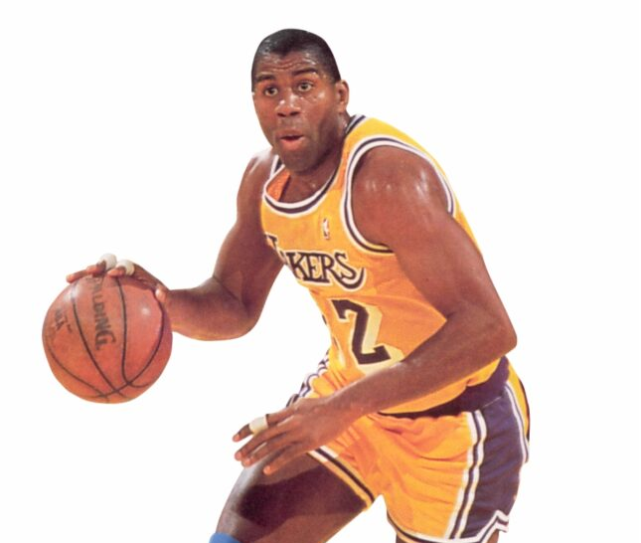
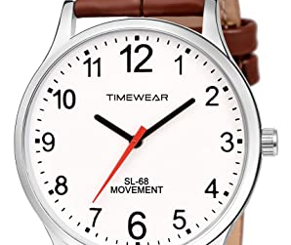

Slide 4
How to do a magic trick
https://youtu.be/u6-ej1ue46c

